Slide 1
Computer Vision and Image Processing
Tirgul 13
Depth by Stereo
& Moriya Bitton

Slide 2



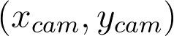


How to obtain depth from a camera?
While looking at the camera model, we saw that we cant tell distances of heights from an image.
?

Slide 3
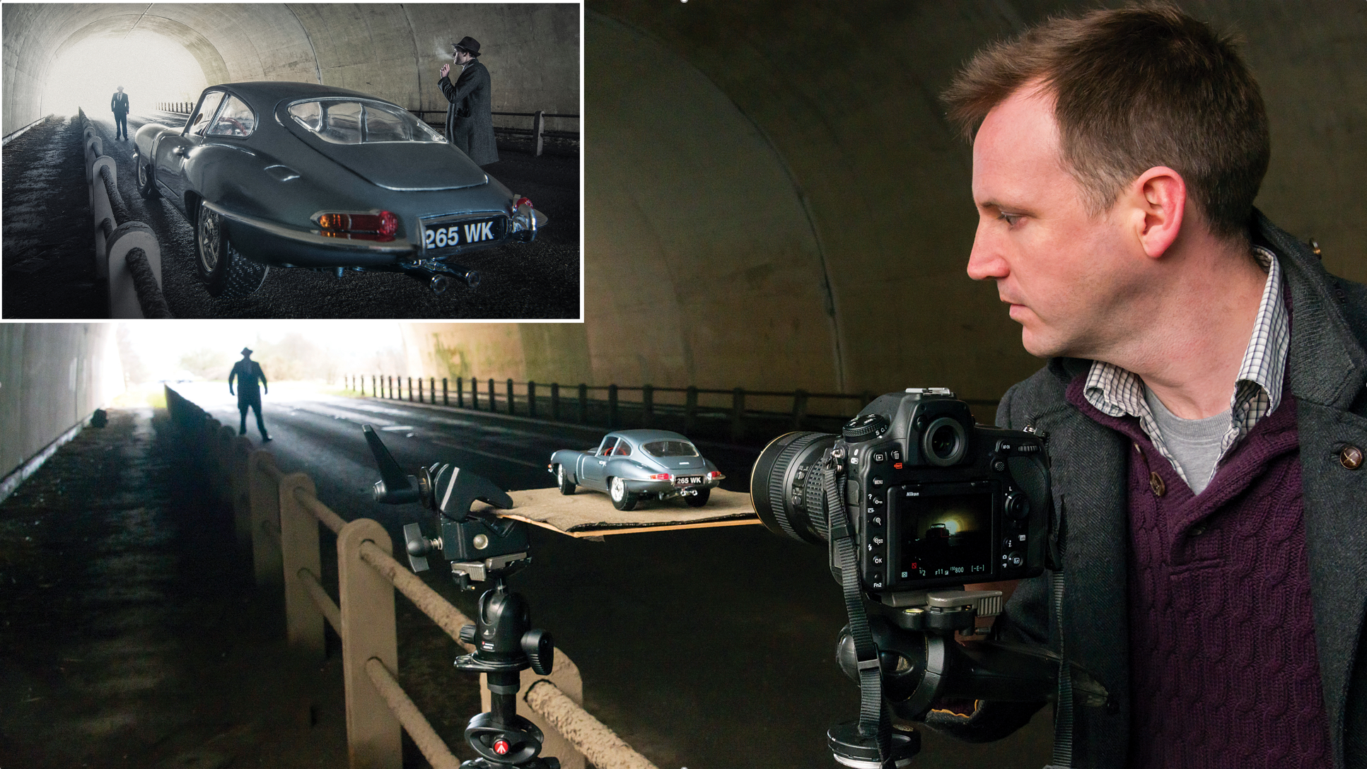

Slide 4
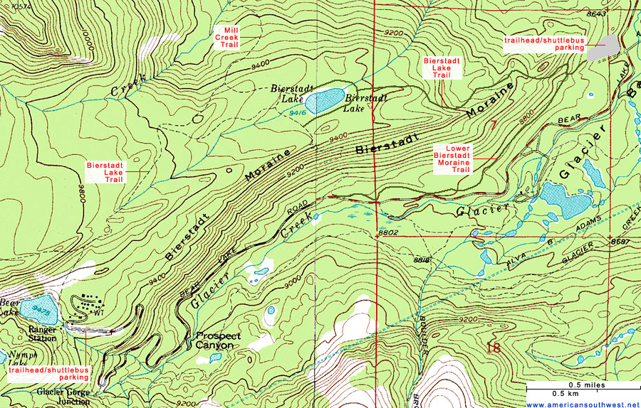
Use two cameras (stereo) for triangularization
The main idea is just like in navigation:

Slide 5

Use two cameras (stereo) for triangularization
The main idea is just like in navigation:
$$315∠$$

Slide 6
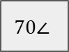

Use two cameras (stereo) for triangularization
The main idea is just like in navigation:
$$315∠$$
$$70∠$$

Slide 7
Use two cameras (stereo) for triangularization
The main idea is just like in navigation:
$$315∠$$
$$70∠$$

Slide 8
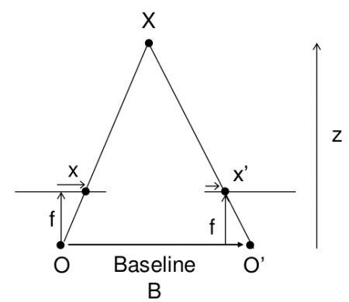
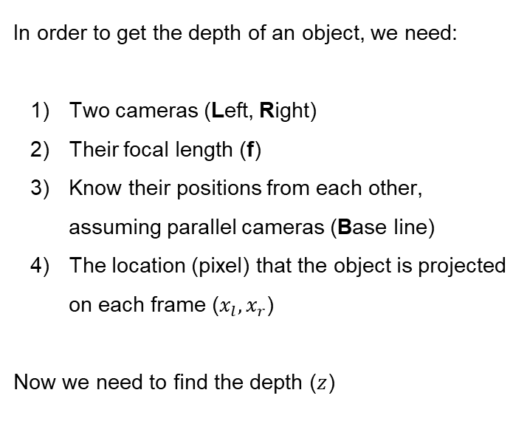
Now with cameras
In order to get the depth of an object, we need:
Two cameras (Left, Right)
Their focal length (f)
Know their positions from each other, assuming parallel cameras (Base line)
The location (pixel) that the object is projected on each frame ($x_{l},x_{r}$)
Now we need to find the depth ($z$)

Slide 9
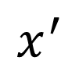
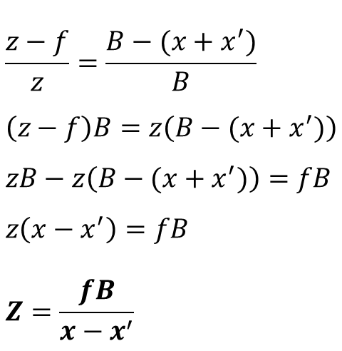
Now with cameras
The green and the red triangle are similar.
$$\frac{z−f}{z}=\frac{B−(x+x^{′})}{B} \\ \left(z−f\right)B=z\left(B−(x+x^{′})\right) \\ zB−z\left(B−(x+x^{′})\right)=fB \\ z\left(x−x^{′}\right)=fB \\ Z=\frac{fB}{x−x^{′}}$$
$$x^{′}$$

Slide 10
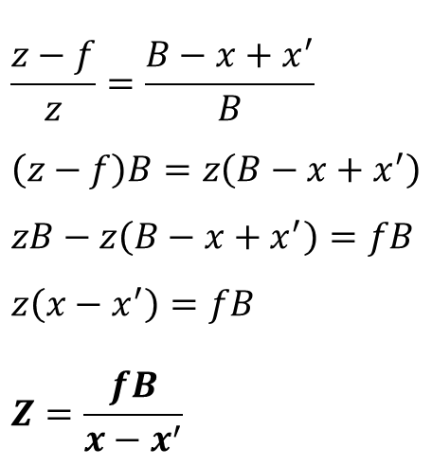
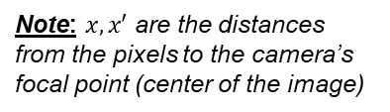
Now with cameras
The green and the red triangle are similar.
$$\frac{z−f}{z}=\frac{B−x+x^{′}}{B} \\ \left(z−f\right)B=z\left(B−x+x^{′}\right) \\ zB−z\left(B−x+x^{′}\right)=fB \\ z\left(x−x^{′}\right)=fB \\ Z=\frac{fB}{x−x^{′}}$$
$$x^{′}$$
Note: $x,x′$ are the distances from the pixels to the camera’s focal point (center of the image)

Slide 11
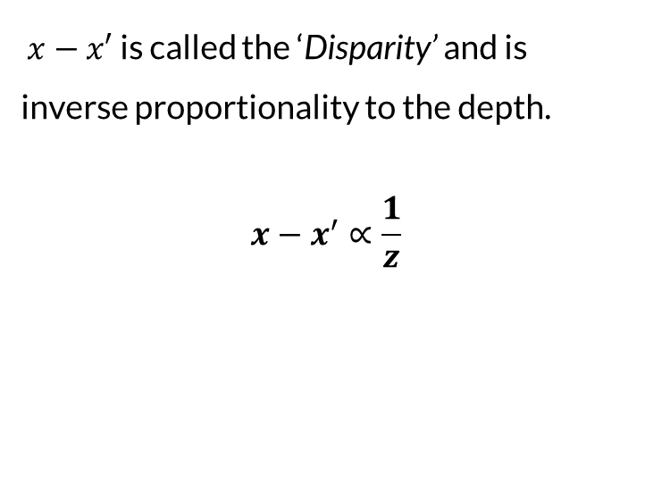
Disparity
$x−x′$ is called the ‘Disparity’ and is inverse proportionality to the depth.
$$x−x^{′}∝\frac{1}{z}$$
Left Frame
Right Frame
Base line

Slide 12
Corresponding points
How do we match points from one frame, to the next?
?

Slide 13
Corresponding points
We need to find the corresponding pixel for each pixel to get a dense depth image.
Keypoints & descriptors (sift etc..): Works good on sparse key points, but will be expensive.
Feature matching (lines, circles….): only sparse, and very expensive.
Cross correlation: too expensive to do for each pixel .
SSD for a small window: too expensive to do for each pixel.

Slide 14
Corresponding points
What if we use SSD, but limit the search?
Introducing: Epipolar planes

Slide 15
Corresponding points
The plane (P,C₁,C₂) connects the focal points of the camera and the objects, and is called ‘Epipolar Plane’.
Thus giving us the ‘Epipolar Line’ which is the projection of the plan on the frame

Slide 16
Corresponding points
Now we have the epipolar line, we have limited our search.
But do we search the whole line?
?

Slide 17
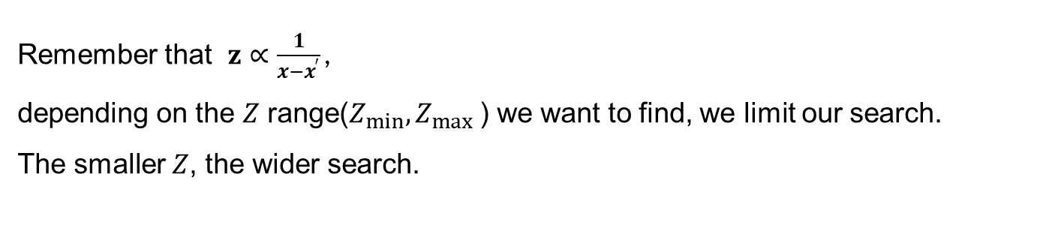
Corresponding points
Remember that $z∝\frac{1}{x−x^{′}}$ ,
depending on the $Z$ range($Z_{min},Z_{max}⁡$) we want to find, we limit our search. The smaller $Z$, the wider search.
?

Slide 18
What if the cameras are not parallel?
Still holds, but usually will not be used do to complexity.

Slide 19
What if the cameras are not parallel?
A common approach for solving this problem, will be to warp the images, and force them to be parallel.

Slide 20
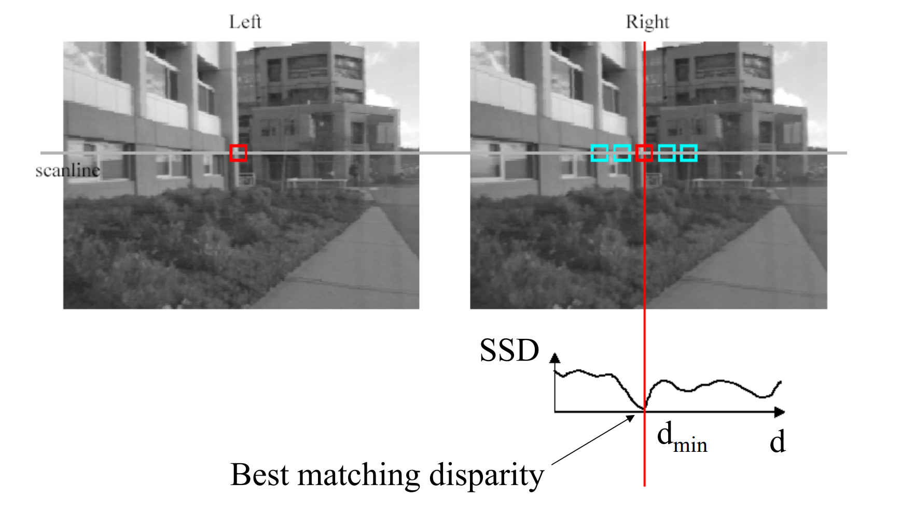
Scanning with SSD
Could be replaced with Cross-Correlation/ NCC.

Slide 21
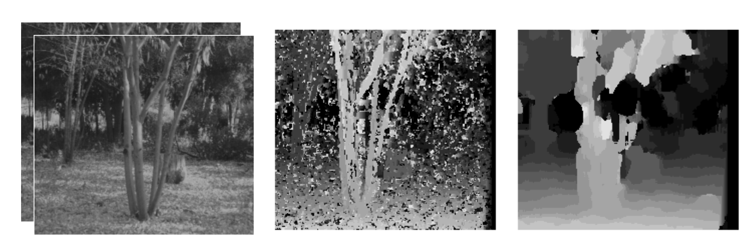
Scan window size
Smaller -
More detail
More noise
Larger -
Less detail
Less noise

Slide 22
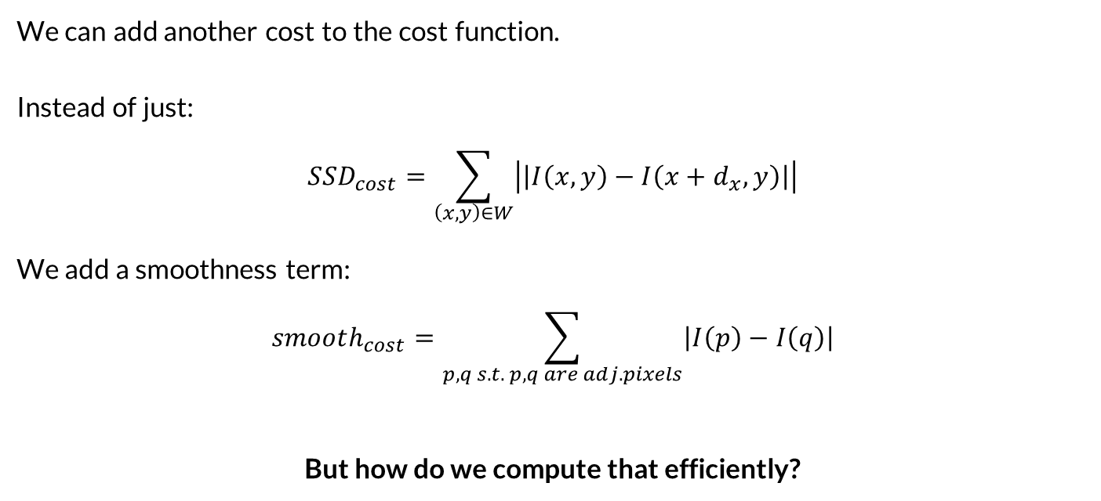
How to solve the noise without losing detail?
We can add another cost to the cost function. Instead of just:
$$SSD_{cost}=\sum_{\left(x,y\right)∈W}{\left|\left|I\left(x,y\right)−I\left(x+d_{x},y\right)\right|\right|}$$
We add a smoothness term: $$smooth_{cost}=\sum_{p,q s.t. p,q are adj. pixels}{\left|I\left(p\right)−I\left(q\right)\right|}$$
But how do we compute that efficiently?

Slide 23
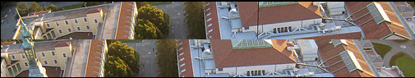
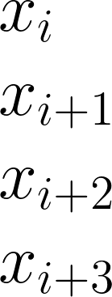
Dynamic Programing
Best matching point

Slide 24

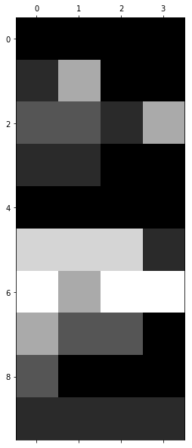
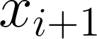


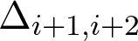
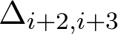
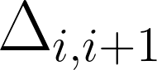
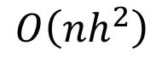
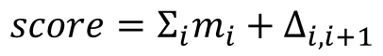
Dynamic Programing
Best match, No smoothness
$$score=Σ_{i}m_{i}+Δ_{i,i+1}$$
$$O\left(nh^{2}\right)$$
Brighter colors means better match

Slide 25
Dynamic Programing
Bad match, Best smoothness
$$score=Σ_{i}m_{i}+Δ_{i,i+1}$$
$$O\left(nh^{2}\right)$$
Brighter colors means better match

Slide 26
Dynamic Programing
Good match and good smoothing
$$score=Σ_{i}m_{i}+Δ_{i,i+1}$$
$$O\left(nh^{2}\right)$$
Brighter colors means better match

Slide 27
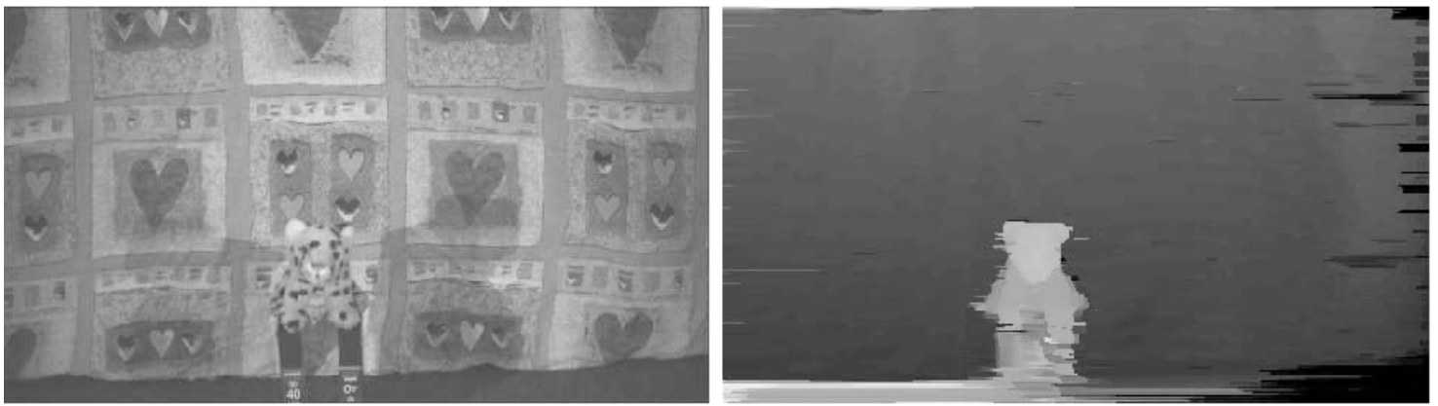

Dynamic Programing
Works good, but only helps smooth along the epipolar line $\left(1D\right)$, and does not smooth the pixels in the second dimention.

